Slide 1

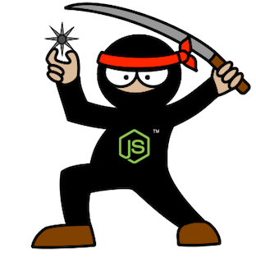
Node.js Novice to Ninja
Guillaume Brossard
David Richer
Sr. Engineer – M&E Cloud Services
Sr. Engineer – M&E Cloud Services
Notes:
Introduce the presenters! I am Guillaume Brossard [and I am David Richer]. We are both senior engineers in the M&E Cloud Services group, located in the Montreal office, in Quebec.
Today we will talk about Node.js and how it can be used in an Enterprise product.

Slide 2

M&E Cloud Services - Context
Kick-off of an initiative composed of 4 teams
Our goals
Ensure shortest learning curve possible
Allow extensive reuse of web components
Facilitate fast development cycle of micro-services
Solutions
Friendly Development Environment
Collaboration – Components Sharing
Easy deployment / lower deployment issues
Notes:
[Guillaume]
The context:
Kick-of of a 20+ developers initiative (end of 2112)
MECS Asset-Based Collaboration: Web Application allowing collaboration, computing and asset management on the Autodesk Cloud.
In DCC integration inside Maya through a QtWebKit UI.
The people:
Mostly senior C++ engineers
Most have no web development experience
The goals:
Ensure shortest learning curve possible
Allow extensive reuse of web components
Facilitate fast development cycle of micro-services
We used our experience on the P42 project, a joint venture with Dreamworks Animation to create a Production Management system.

Slide 3
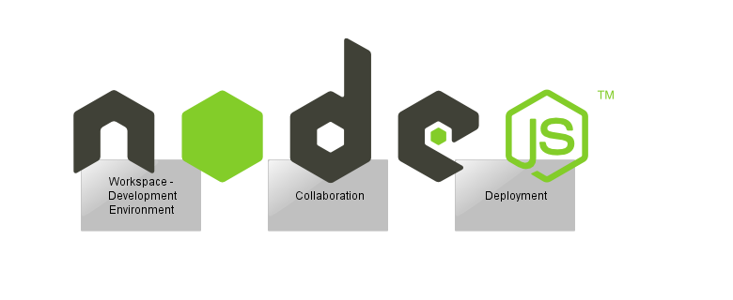
Overview – Node.js
Notes:
[Guillaume]
Platform built on V8 engine (Chrome)
Google’s open source, C++ based JavaScript engine that actually runs JavaScript.
Node.js team took this C++ code and added other important libraries like TCP, HTTP and DNS to create Node.js
Non-blocking, event-driven I/O
Single threaded
SEE NEXT SLIDE
Designed for distributed, data-intensive, real-time applications
Services written in JavaScript
Native C++ modules for computation intensive routines

Slide 4
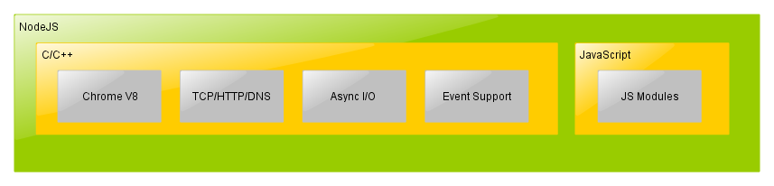
Node.js – What is it?
Notes:
[Guillaume]
Platform built on V8 engine (Chrome)
Google’s open source, C++ based JavaScript engine that actually runs JavaScript.
Node.js team took this C++ code and added other important libraries like TCP, HTTP and DNS to create Node.js
Non-blocking, event-driven I/O
Single threaded
SEE NEXT SLIDE
Designed for distributed, data-intensive, real-time applications
Services written in JavaScript
Native C++ modules for computation intensive routines

Slide 5
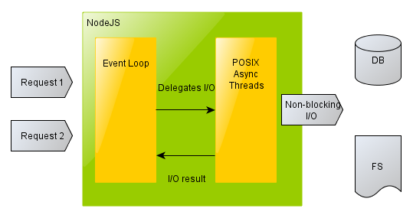
Node.js – I/O
Notes:
[Guillaume]
Non-blocking, event-driven I/O
Single threaded
In order to write a fast and scalable server application, we typically end up writing it in a multi-threaded fashion. While you can build great multi-threaded apps in many languages, it usually requires a lot of expertise to build them correctly. On the other hand, these libraries (along with Chrome’s V8 engine) provide a different architecture that hides the complexities of multi-threaded apps while getting the same or better benefits.
At the front, you have Chrome V8 engine (single threaded), event loop and other C/C++ libraries that run your JS code and listen to HTTP/TCP requests.
At the back of the server, you have libuv (includes libio) and other C/C++ libraries that provide asynchronous I/O.

Slide 6




Why Node.js?
Same language client-side/server-side
Asynchronous by nature
Simpler I/O model, free of locking and concurrency issues
Large collection of quality open source modules
Node.js as the only dependency!
Notes:
[Guillaume]
Node.js Overall:
Low I/O cost
Low Memory footprint
A lot of public libraries, really popular
May not be wanted on the long term, but helps getting out the starting blocks
For us:
Scalability and stability proven by many serious users (LinkedIn, eBay, Yahoo)
Fast ramp up for our inexperienced developers
Node.js only dependency:
Development Environment set-up
Development
Infrastructure bindings (database, queues, etc.)
Tools (Task Runner aka Grunt, QA, etc.)

Slide 7
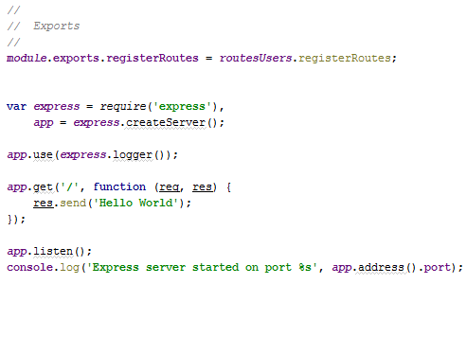
Express.js Hello World
Notes:
[Guillaume]
Transition: Node.js is great for developping module and small services, but what is missing for Node to be used in an enterprise team?

Slide 8
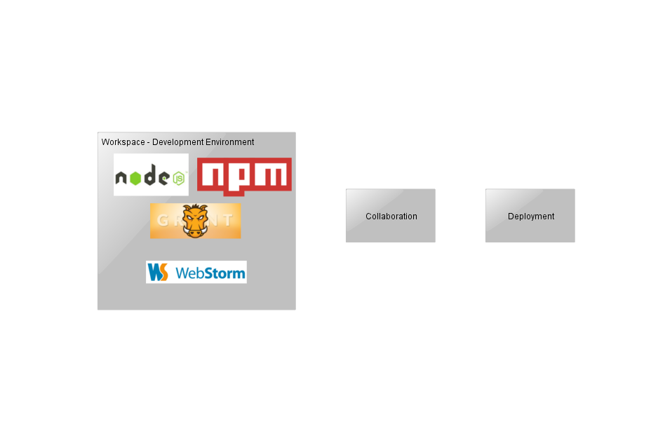
Overview – Development Environment
Notes:
[David]
Node.js provide a lot for module size projects. But what about building big projects around Node.js? What is missing and/or not provided out of the box by Node.js?
We had the leisure to build the development environment from scratch, without any restriction from legacy applications or restriction on the technology to choose.
We wanted our environment to be developer centric, optimized for developer daily workflow.
At the same time, we wanted to facilitate deployment, to limit the bugs that sometimes appear when deploying in the Cloud.
The dream was to allow developers to quickly spawn the whole stack on their local workstation, on a VM network or on Amazon, each environment being as similar as possible to one another (increase development/production parity) -> DevOps
Also, the teams needs to be able to easily share components. (to develop)

Slide 9
Node.js for Enterprise
Attractive developer environment
Extensive sharing of components between teams
Easy Deployment (DevOps)
Local
VM
Amazon
Notes:
[David]
Node.js provide a lot for module size projects. But what about building big projects around Node.js? What is missing and/or not provided out of the box by Node.js?
We had the leisure to build the development environment from scratch, without any restriction from legacy applications or restriction on the technology to choose.
We wanted our environment to be developer centric, optimized for developer daily workflow.
At the same time, we wanted to facilitate deployment, to limit the bugs that sometimes appear when deploying in the Cloud.
The dream was to allow developers to quickly spawn the whole stack on their local workstation, on a VM network or on Amazon, each environment being as similar as possible to one another (increase development/production parity) -> DevOps
Also, the teams needs to be able to easily share components. (to develop)

Slide 10
npm - Node.js Package Manager
Easy integration of JavaScript and C/C++ modules
npm registry
One command to rule them all
npm install
Configuration through a JSON file
Each module controls its dependencies versions
Notes:
[David]
TECHNICAL NOTES:
- Node.js modules follows CommonJS specification (ecosystem specification out of the browser)
- Inspired from RubyGems
- Native modules are built using node-gyp (MSVC 2010/2012 on Windows, GCC on Unix)

Slide 11
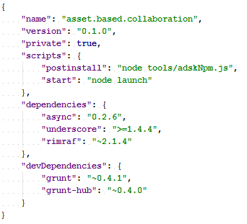
npm - Package.json
Notes:
[David]

Slide 12
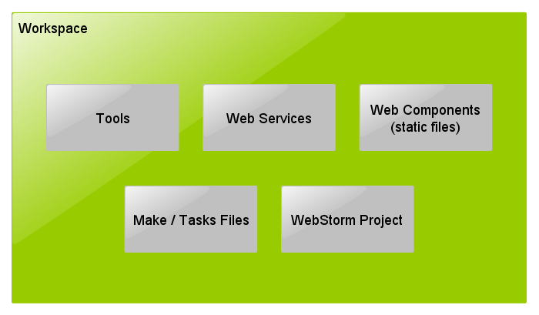
Development Environment - Workspace
Notes:
[Guillaume]
Developer workspace + components (services/web/api)
Split between web services and static content
Self contained environment for developers
Install all dependencies
Start all services
Run all tests

Slide 13
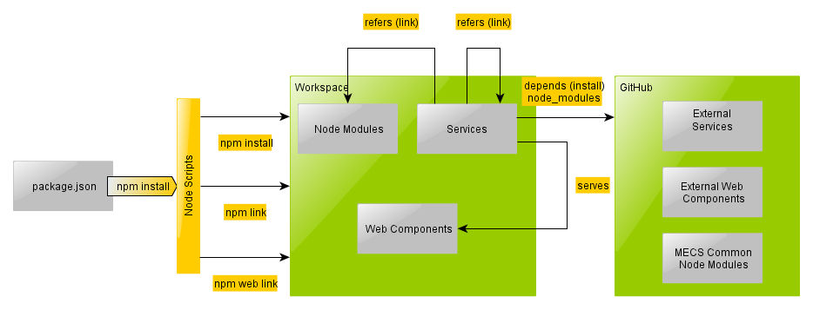
Development Environment
Notes:
[Guillaume]
Leveraging npm power for our needs
Extend package.json to support linkDependencies, create symbolic link when a web service use a node module in the same workspace
One step installation using npm postinstall script
Easy to extend package.json format
webDependencies create symbolic link to web component that are served by the web service.
git.autodesk.com + npm support fetch node module directly from a git repositry
Only fetch tag version of repository to promote stability

Slide 14
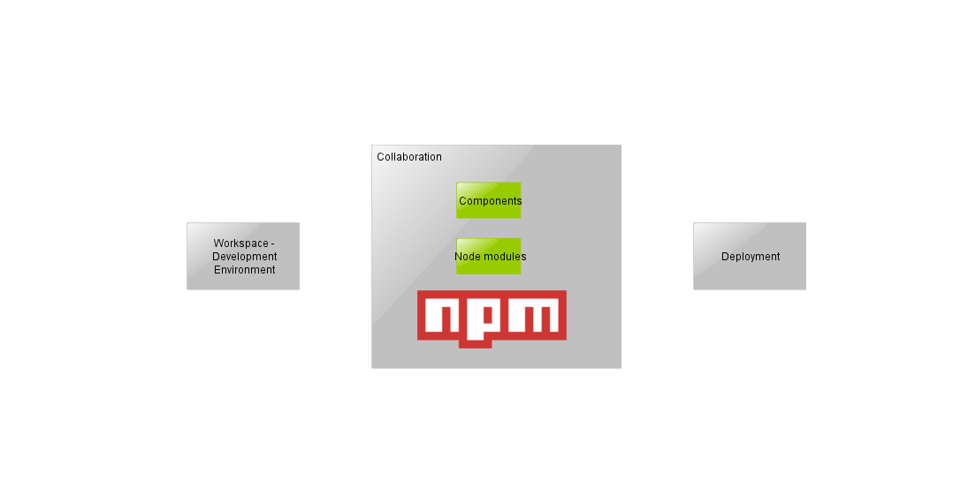
Overview - Collaboration
Notes:
[Guillaume]
Developer workspace + components (services/web/api)
Split between web services and static content
Self contained environment for developers
Install all dependencies
Start all services
Run all tests

Slide 15
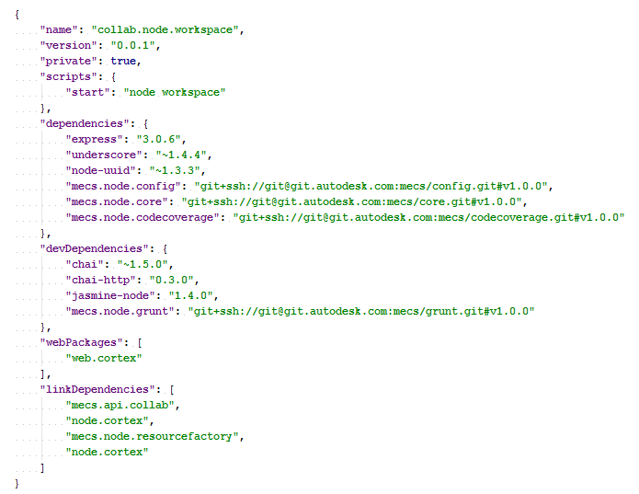
Sharing node modules between teams
npm registry
Common modules
Web Application
Static serving
(JS, HTML, CSS, etc.)
Internal modules
Link to image
Notes:
[Guillaume]
git.autodesk.com + npm support fetch node module directly from a git repositry
Only fetch tag version of repository to promote stability

Slide 16



Development Environment
Grunt.js - JavaScript task runner for Node.js
Tests, static analysis, code coverage
Great community creating grunt plugins
Continuous build integration
Notes:
[Guillaume]
Great to use the same language for the task runner and for the development

Slide 17
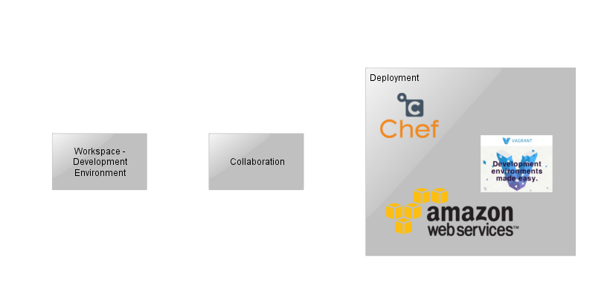
Overview - Deployment
Notes:
[Guillaume]
Great to use the same language for the task runner and for the development

Slide 18
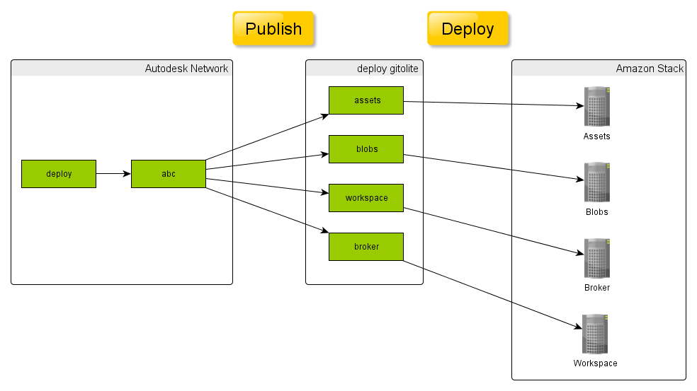
Deployment – Publish Node.js Web Service
Notes:
[David]
During publish, we package each web service with all his dependencies both internal and external. This allow us to deploy in the cloud without access to autodesk git server.
Faster and reproducable build to deploy.

Slide 19
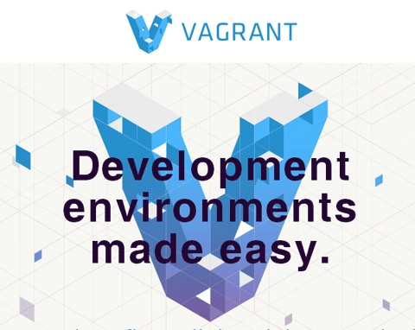
Deployment - VM
Vagrant
Minimize difference between VM deployment and Amazon
Great way to quickly test Chef cookbooks
Notes:
[David]
Vagrant is a tool to quickly spawn VM using a provisioner like Chef. Completely automated.
Same base Ubuntu linux as on Amazon, very limited difference. Mostly networking difference.
Same chef cookbooks
Great tools to quickly test your Chef cookbooks

Slide 20

Deployment – Opscode Chef
Configuration Management Software
Manage configuration, not individual servers
Infrastructure as code
Cookbooks maintained by sys admins AND developers
Open Source
Notes:
[David]
Existing cookbooks to install Node.js, deploy Node.js application, install MongoDB
All cookbooks are available on GitHub and easy to modify!

Slide 21

Deployment - Amazon
Amazon Cloud Formation
Script to generate Cloud Formation file to reduce redundancies
EC2 instance are provisioned from vanilla Ubuntu using Chef
Route53 provide DNS for each stack
test.sandbox.scotty.mecs.autodesk.com
Notes:
[David]
We start from vanilla Ubuntu image
Create a coherent stack that contains all Amazon resource, easy to create, update and delete.
A big json describing a whole Amazon Stack
We use a script to generate the Cloud Formation file to reduce redundancies.
Individual EC2 instance are provisioned from vanilla Ubuntu image using Chef
Can configure Amazon Route 53 DNS service from Cloud Formation to have cute name for all stacks.

Slide 22
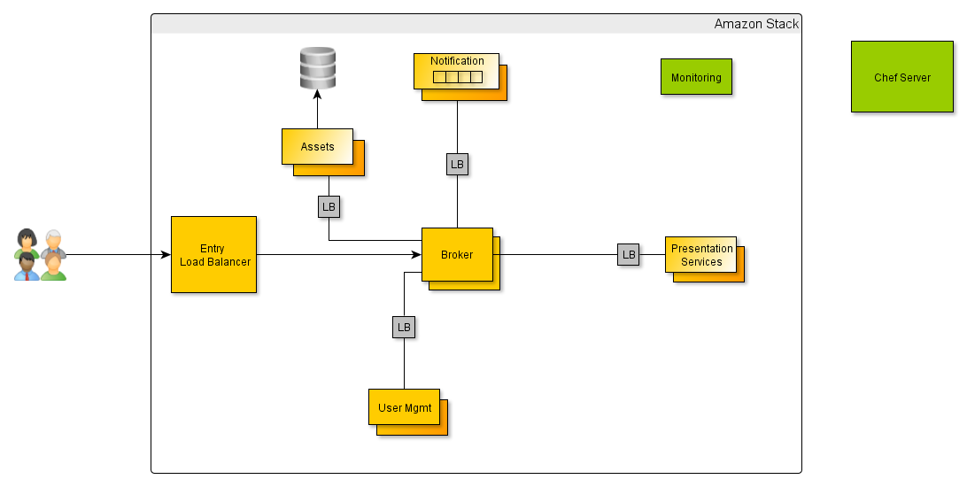
Deployment - Amazon
Notes:
[David]
Deploy EC2 machine in Auto Scaling Groups
Deploy Load Balancers
Deploy databases

Slide 23


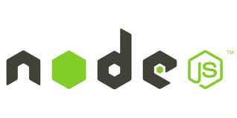




Conclusion
Notes:
[David]
Full JavaScript stack
Hipster technology gaining credibility [DR]
Node modules
Databases: MongoDB, CouchDB, PostgreSQL, etc.
Amazon : aws-sdk, awssum
Build automation : Grunt.js
Chef recipes (deployment)
WebStorm – Node.js ready

Slide 24
Autodesk is a registered trademark of Autodesk, Inc., and/or its subsidiaries and/or affiliates in the USA and/or other countries. All other brand names, product names, or trademarks belong to their respective holders. Autodesk reserves the right to alter product and services offerings, and specifications and pricing at any time without notice, and is not responsible for typographical or graphical errors that may appear in this document.

Slide 25
Appendices

Slide 26
Technologies List
Development Environment
Node.js
npm
Grunt (Task Runner)
WebStorm (IDE)
Git Enterprise
Source Tree (Git Graphical Client)
Deployment
Gitolite (Light-weight git server)
Chef (Configuration Mgmt Tool)
Vagrant (Virtual DevEnv)
Amazon Web Services
Amazon Cloud Formation
Node.js Modules / JavaScript Libraries
express.js
async
underscore
nconf
aws-sdk
QA
JSLint (Static Code Analyzer)
Jasmine (BDD Testing framework)
Chai (BDD-TDD Assertion Library)
Istanbul (Code Coverage)
Karma (Test Runner)

Slide 27
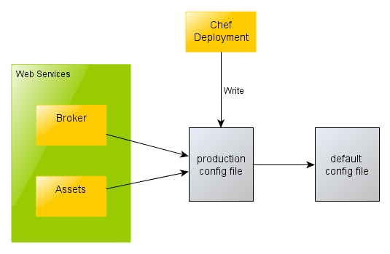
Deployment – Application Configuration
Notes:
[David]
Deployment can override defaults, chef generate a production.json

Slide 28
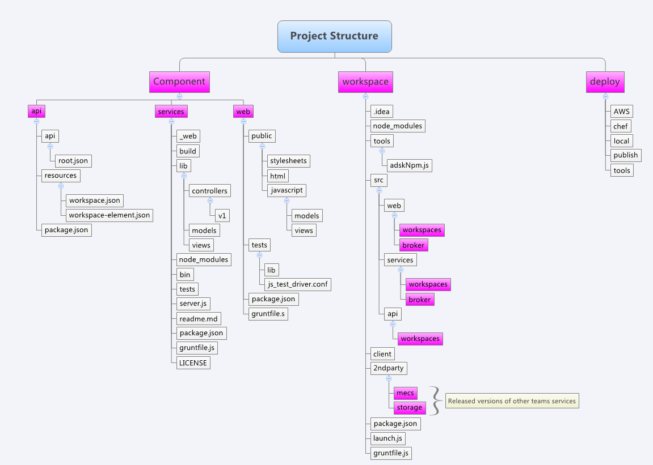
Code Organization
Link to image

Slide 29
Release Management
Content

Slide 30
Node.js - Pros and Cons
Still a really young technology
No solutions for trivial stuff (simple CRUD)
Consistent error-handling
Consistent HTML error codes
Bad at static file serving
Persistent memory
Increased changes for memory leaks
Easy to share data between clients

Slide 31
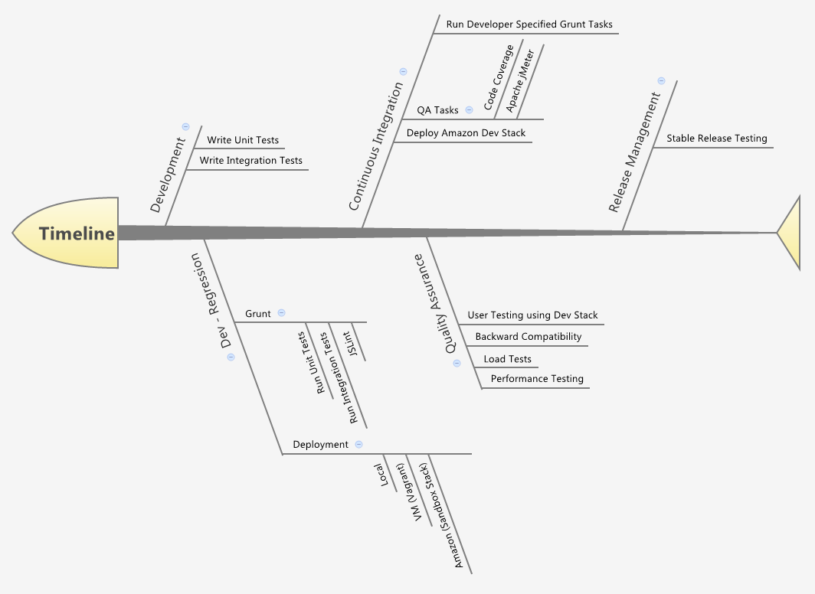
Quality Assurance Process
Link to image

Slide 32
Autodesk is a registered trademark of Autodesk, Inc., and/or its subsidiaries and/or affiliates in the USA and/or other countries. All other brand names, product names, or trademarks belong to their respective holders. Autodesk reserves the right to alter product and services offerings, and specifications and pricing at any time without notice, and is not responsible for typographical or graphical errors that may appear in this document.

